Slide 1
Induced Surface Charge
Xuan Ruan

Slide 2
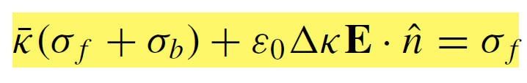










Equations
$$E$$
$$\hat{n}$$
Governing equation:
$$σ_{f}+σ_{b}$$
$$κ_{out}$$
$$κ_{in}$$
Dielectric constant:
Unknown
Known

Slide 3
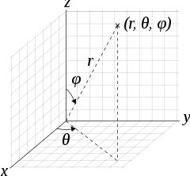
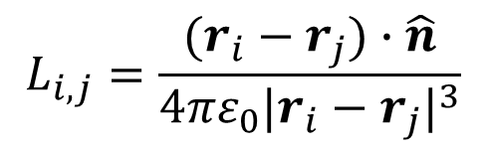

Equations
$$E$$
$$\hat{n}$$
$$σ_{f}+σ_{b}$$
$$κ_{out}$$
Unknown
Known
$$κ_{in}$$
$$\overline{κ}σ_{b,i}+ε_{0}ΔκL_{i,j}({dSσ}_{b,j})=b_{i}$$
$$L_{i,j}=\frac{(r_{i}−r_{j})∙\hat{n}}{4πε_{0}{|r_{i}−r_{j}|}^{3}}$$

Slide 4
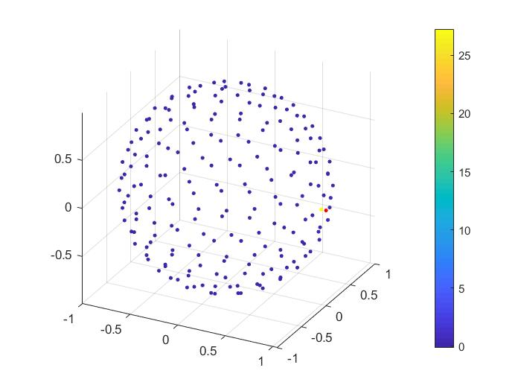
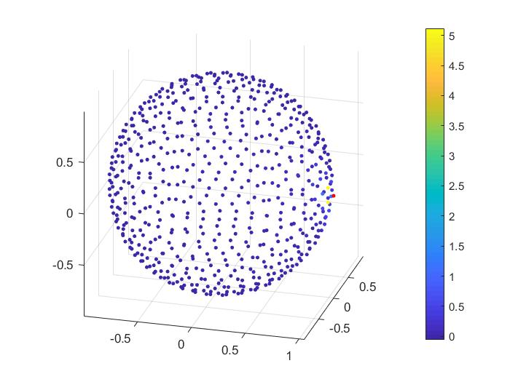
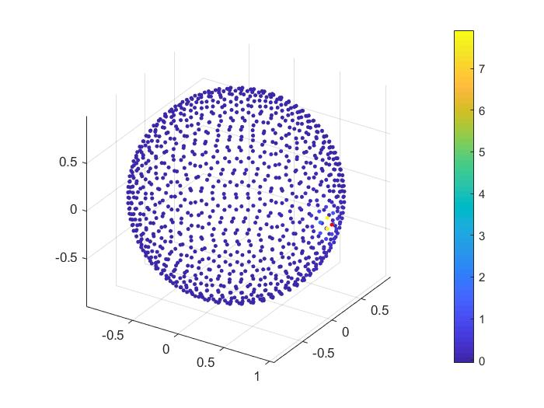
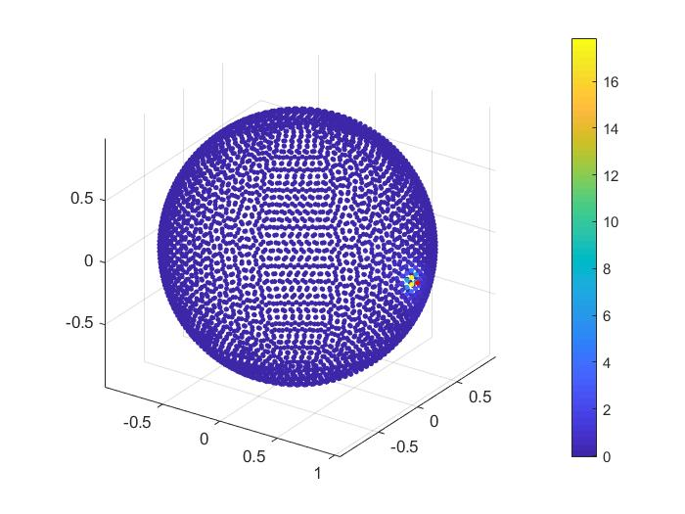

Number of patches
$$\frac{κ_{obj}}{κ_{m}}=2.5,\frac{d_{p}}{R}=0.05$$
N=200
N=600
N=1024
N=4000

Slide 5
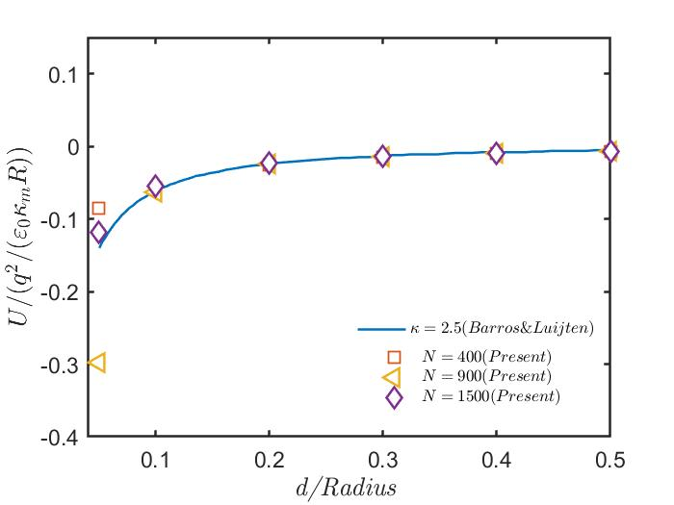
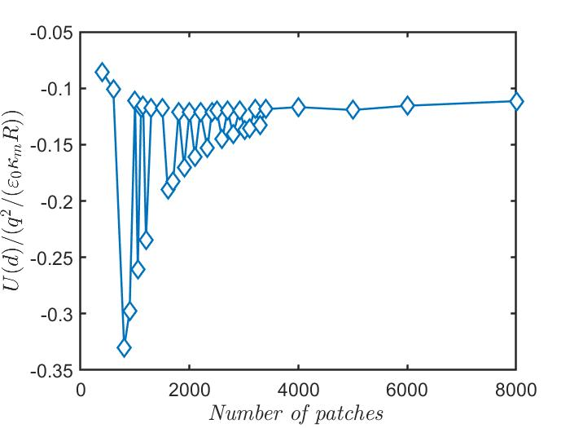
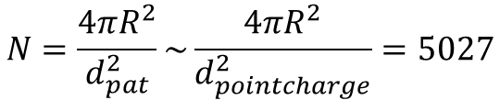



Number of patches
$$\frac{κ_{obj}}{κ_{m}}=2.5,\frac{d_{pointcharge}}{R}=0.05$$
N: number of patches
$$a_{pat}=\frac{4πR^{2}}{N},d_{pat}=\sqrt{a_{pat}}$$
$$N=\frac{4πR^{2}}{d_{pat}^{2}}\sim \frac{4πR^{2}}{d_{pointcharge}^{2}}=5027$$
$$d_{pointcharge}\sim d_{pat}$$

Slide 6
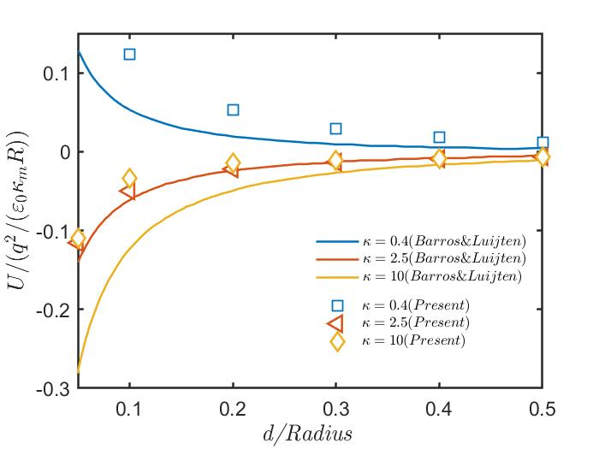

Different dielectric constants
$$N=6000$$

Slide 7
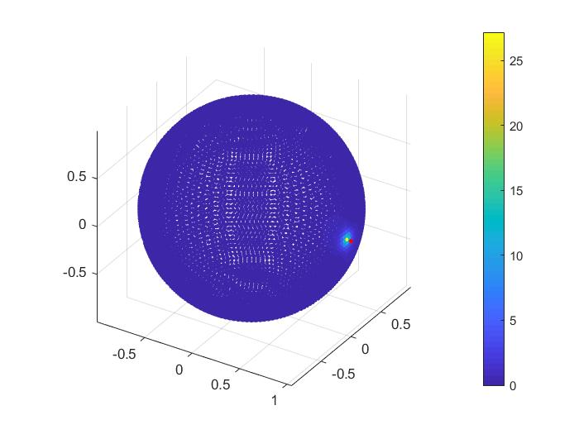

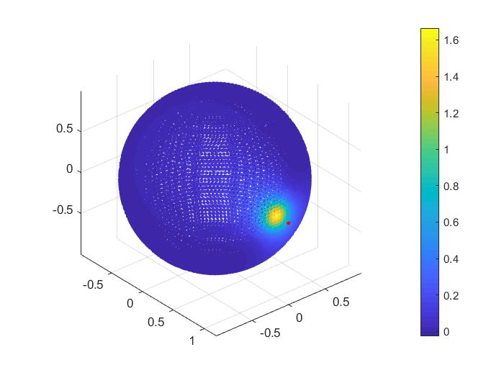
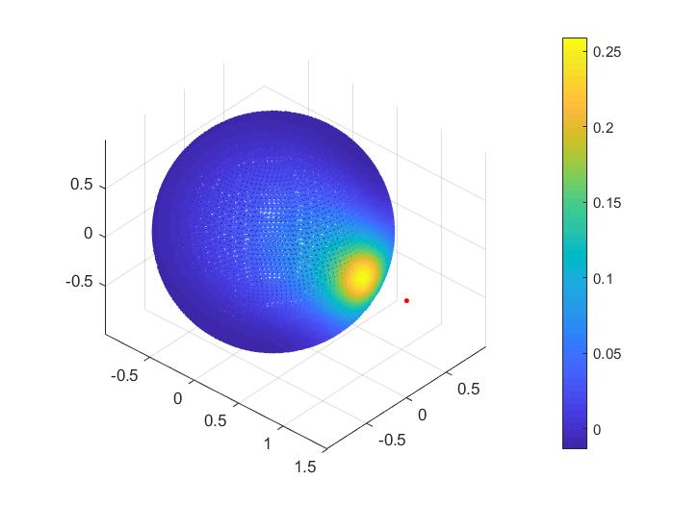

Different distances
$$\frac{κ_{obj}}{κ_{m}}=2.5,N=8000$$
d=0.05R
d=0.1R
d=0.2R
d=0.5R

Slide 8
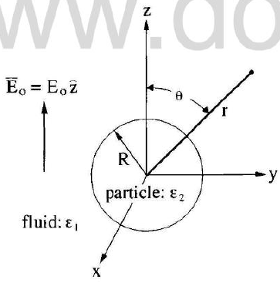


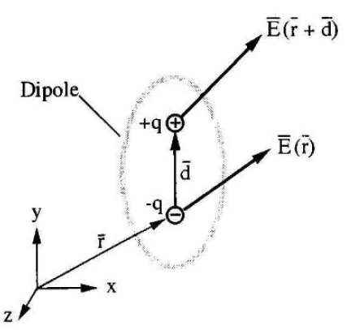
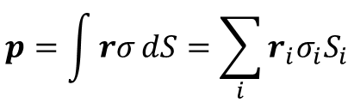

Dielectric ball in an external field
Thomas Jones, Electromechanics of Particles, 1995.
Theoretical solution:
Coefficient A:
Dipole: $p=qd$
$$p=\int{rσ}dS=\sum_{i}{r_{i}σ_{i}S_{i}}$$
Integral form
Discrete form

Slide 9
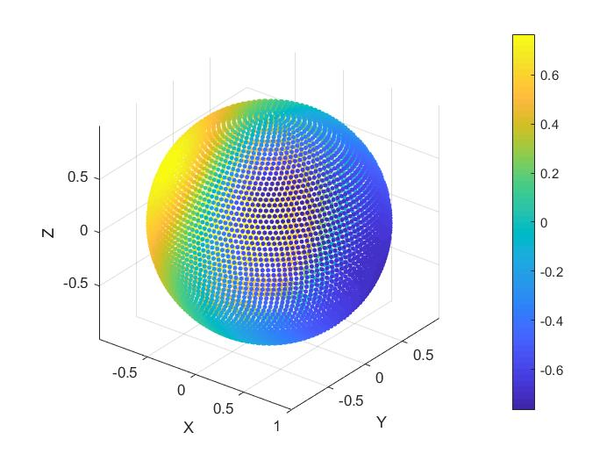
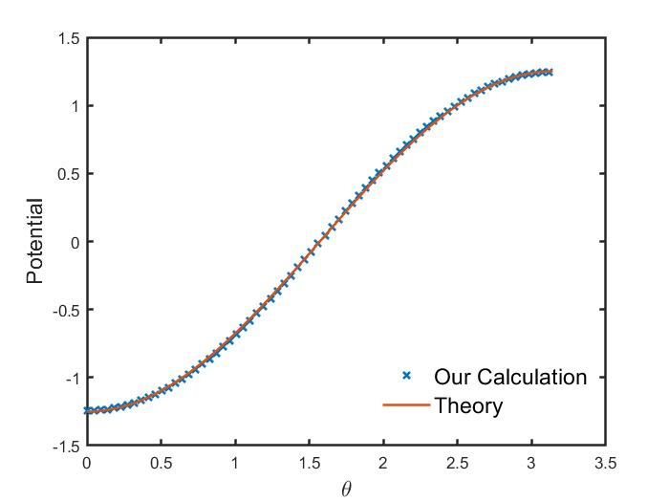
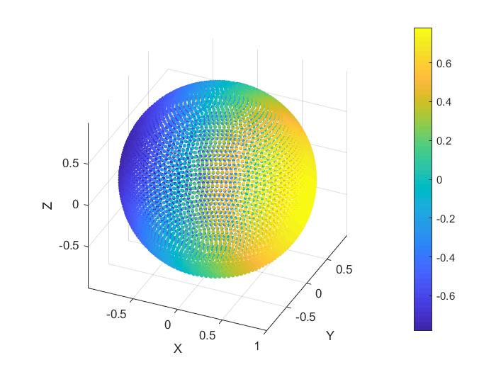
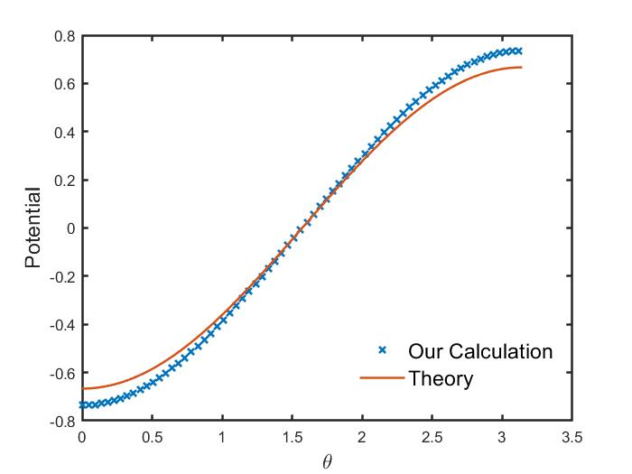

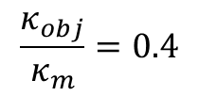




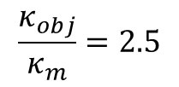
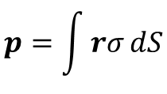
Dielectric ball in an electric field
$$N=6000,\frac{d_{pointcharge}}{R}=0.05$$
$$p=\int{rσ}dS$$
$$\frac{κ_{obj}}{κ_{m}}=0.4$$
$$d_{p,our}=[−3.50,0,0]$$
$$d_{p,theory}=[−3.14,0,0]$$
$$\frac{κ_{obj}}{κ_{m}}=2.5$$
$$d_{p,our}=[3.612,0,0]$$
$$d_{p,theory}=[4.19,0,0]$$

Slide 10
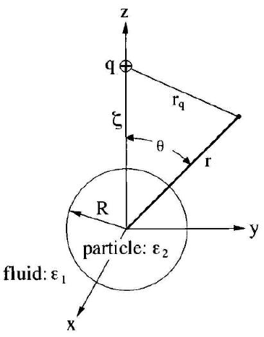



Dielectric ball in field of point charge
Thomas Jones, Electromechanics of Particles, 1995.
Theoretical solution:
Coefficient An:
Legendre polynomial Pn:

Slide 11
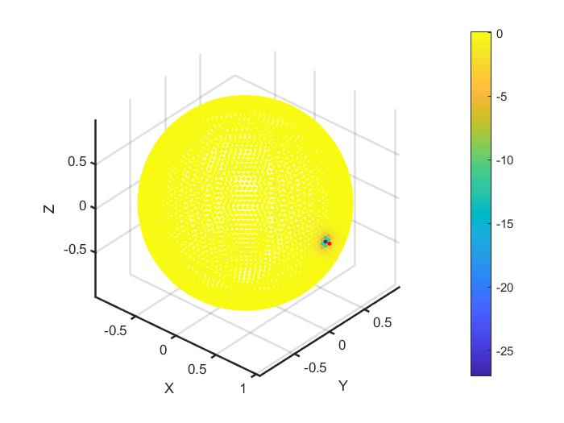
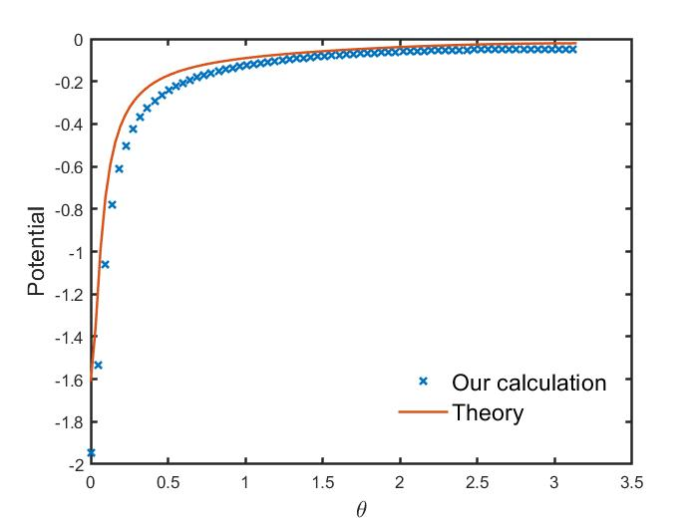
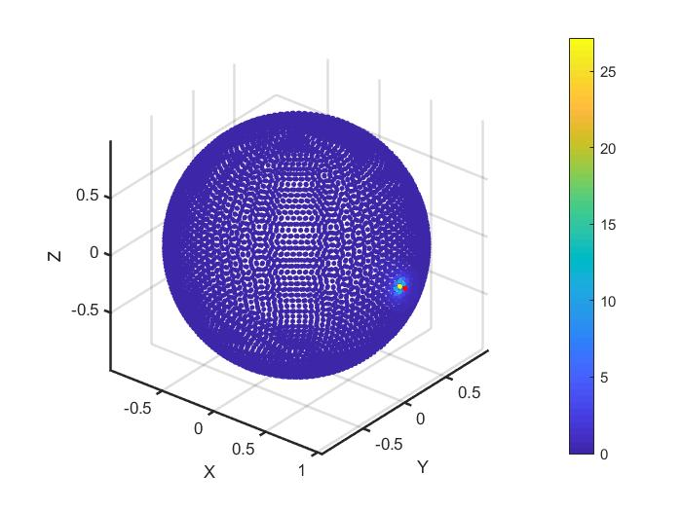
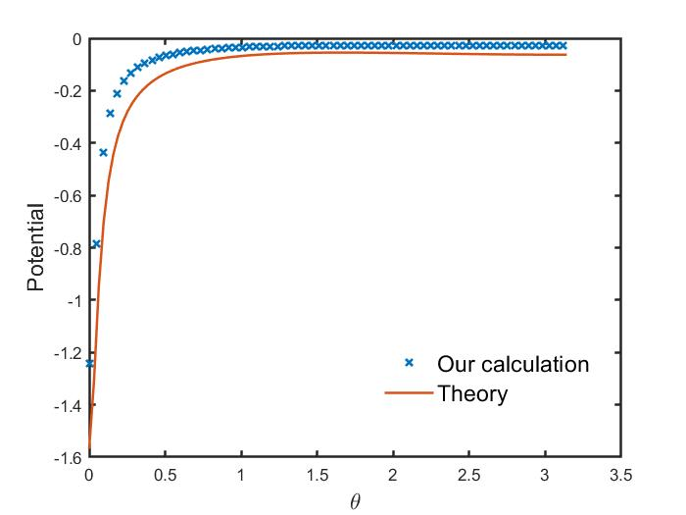
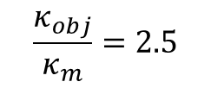
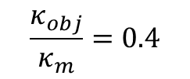
Dielectric ball in field of point charge
$$N=6000,\frac{d_{pointcharge}}{R}=0.05$$
$$\frac{κ_{obj}}{κ_{m}}=0.4$$
$$\frac{κ_{obj}}{κ_{m}}=2.5$$

